Slide 1

Using Directories Listing Files
Linux Essentials
Session-4

Slide 2
Files and Directories
1

Slide 3
Files and Directories
The file system hierarchy standard (FSH) defines the structure of the file systems on Linux.
In the FHS, all files and directories appear under the root directory /, even if they are stored on different physical or virtual devices.
Most of these directories exist in all UNIX, however, they are not considered authoritative for platforms other than Linux.

Slide 4
Files and Directories
/root
Home directory of the root user
/bin
Essential command binaries
/boot
Boot loader files
/dev
Essential device files
/etc
Host-specific configuration files
/home
Users’ home directories
/lib
Libraries essential for the binaries
/mnt
Temporarily mounted filesystems.
/opt
Optional application packages
/proc
Contains information about system
/sbin
Essential system binaries
/tmp
Temporary files
/var
Variable data files

Slide 5
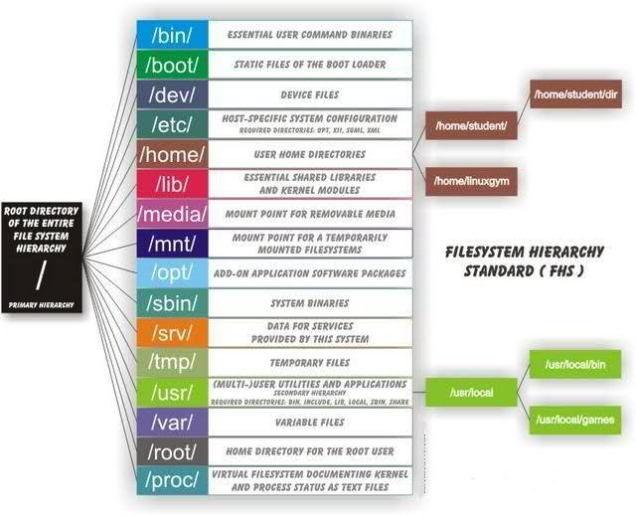
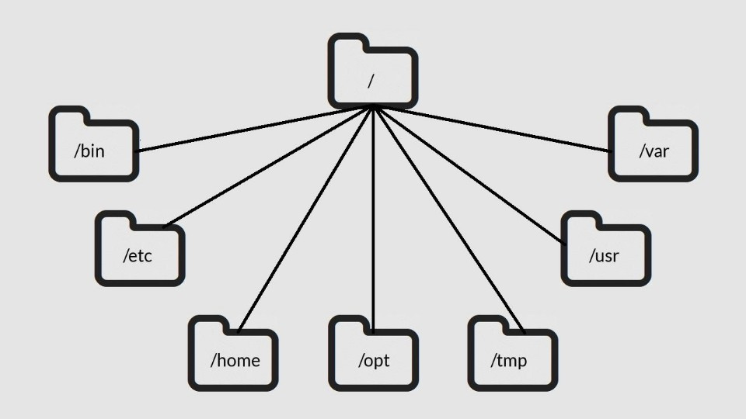
Files and Directories

Slide 6
File Permission
2

Slide 7


File Permission
Ownership
User
Group
Other

Slide 8



File Permission
Permissions
Read
Write
Execute

Slide 9
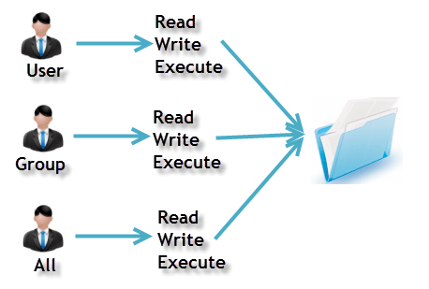
File Permission
Ownership
Permission
A user is the owner of the file.
This permission give you the authority to open and read a file.
User
Read
A user- group can contain multiple users.
The write permission gives you the authority to modify the contents of a file.
Group
Write
Any other user who has access to a file.
you cannot run a program unless the execute permission is set.
Other
Execute

Slide 10
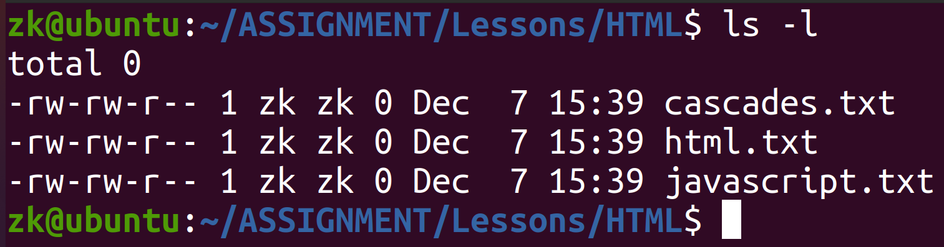
File Permission
Ownership
Other
Group
User

Slide 11
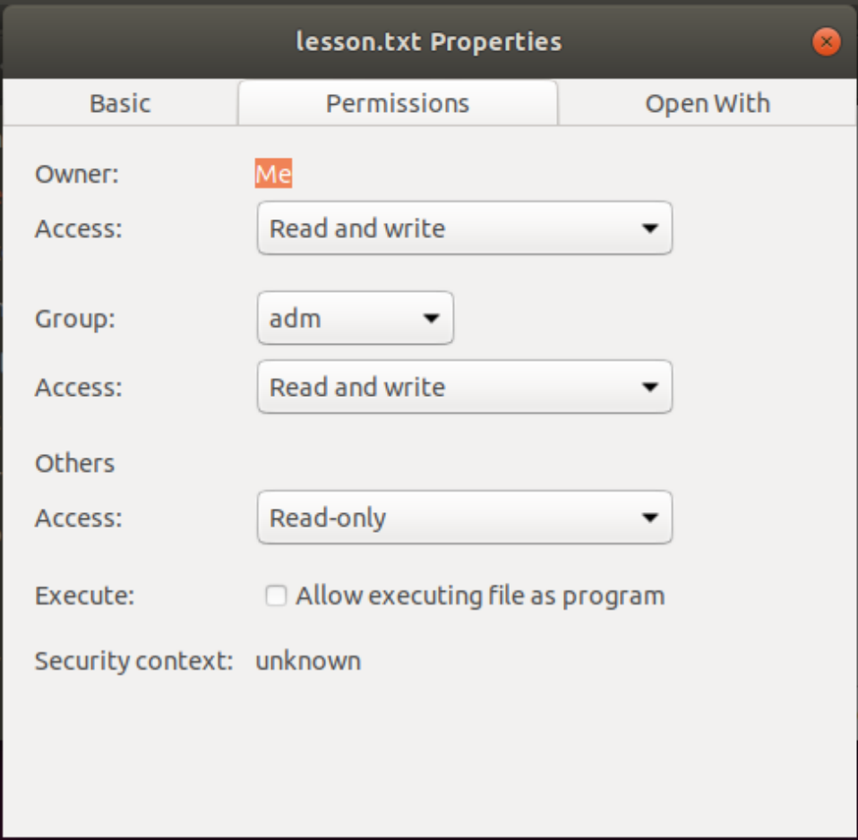
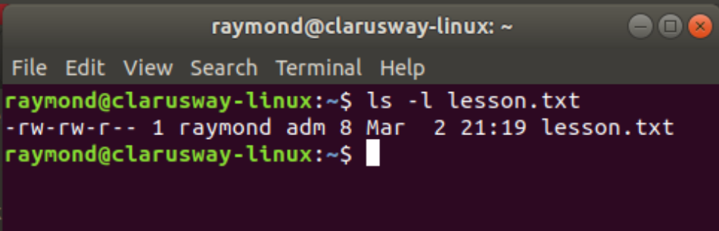
File Permission

Slide 12
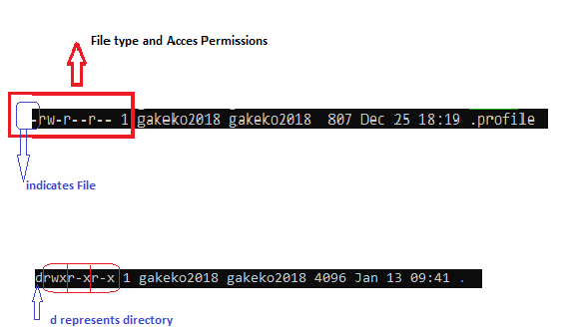
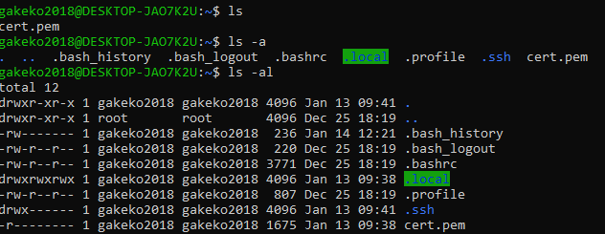
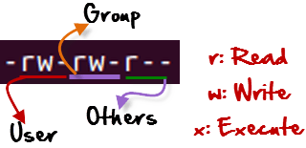
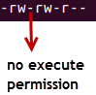
File Permission
r = read permission
w = write permission
x = execute permission
- = no permission

Slide 13
File Permission
Changing Permission with chmod Command
We can use the chmod command which stands for change mode.
we can set permissions (read, write, execute) on a file/directory for the owner, group and the world.
Symbol | Permission Type
--- | No Permission
--x | Execute
-w- | Write
-wx | Execute+Write
r-- | Read
r-x | Read+Execute
rw- | Read+Write
rwx | Read+Write+Execute
chmod permissions filename
chmod u=rwx,g=rx,o=r myfile
Notes:
https://www.howtogeek.com/437958/how-to-use-the-chmod-command-on-linux/

Slide 14
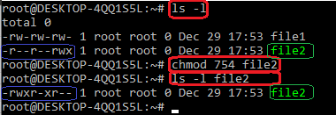
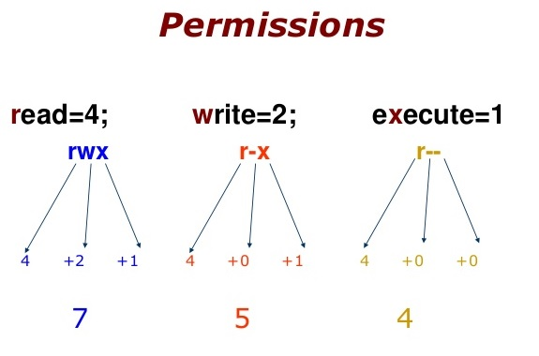
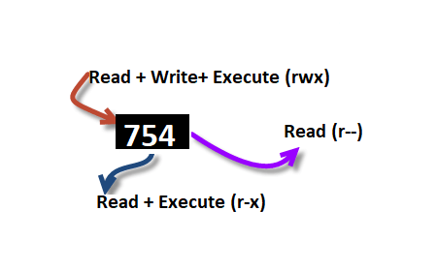
File Permission
754 code says;
Owner can read, write and execute
User’s group can read and execute
Other can only read
chmod u=rwx,g=rx,o=r myfile
chmod 754 myfile

Slide 15
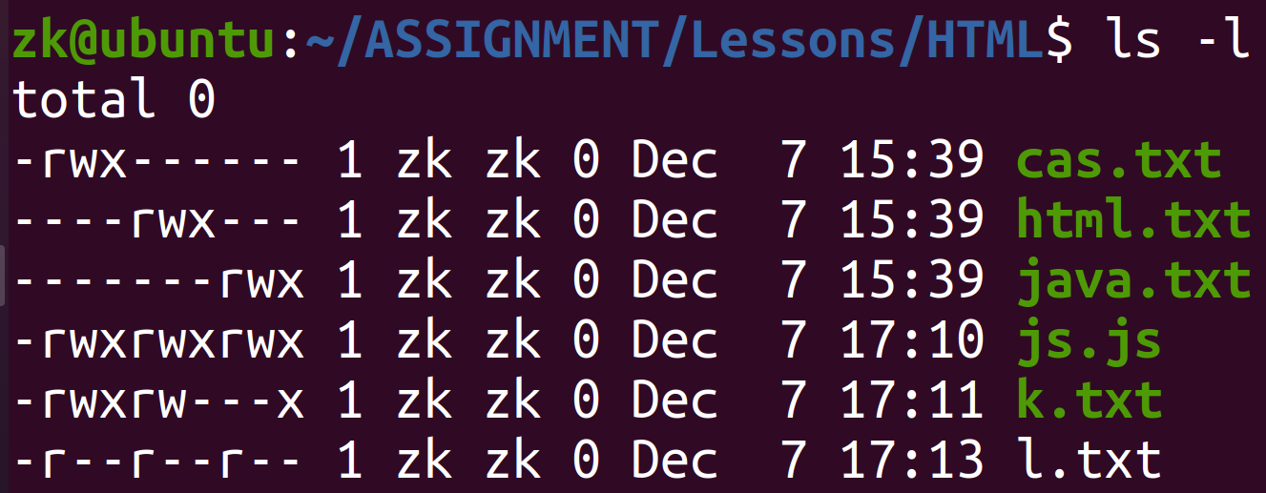
File Permission
!
!

Slide 16
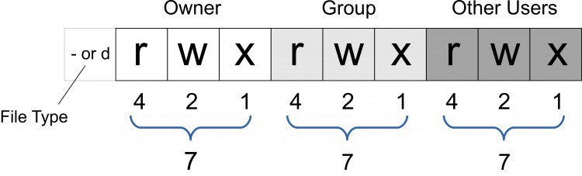
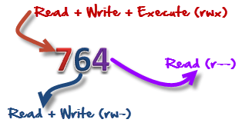

File Permission

Slide 17

Set permissions of myfile.txt to;
owner : full access
group : read and execute
others : no access
Notes:
🍐 This is a Pear Deck Text Slide
🍐 To edit the type of question, go back to the "Ask Students a Question" in the Pear Deck sidebar.

Slide 18
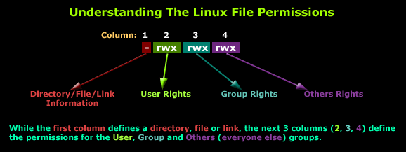
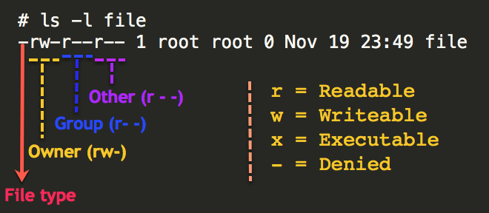
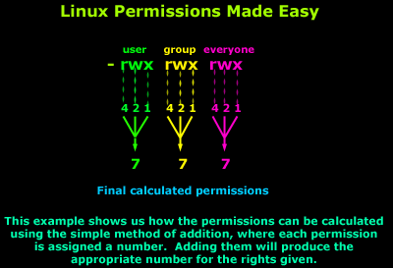

Slide 19
Ping & SSH Command
3

Slide 20
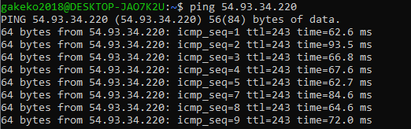
Ping Command
Ping or Packet Internet Groper is a network administration utility used to check the connectivity status between a source and a destination device.
ping host-name/IP
ping 54.93.34.220

Slide 21
Ping Command
The ping command is one of the most used utilities for troubleshooting, testing, and diagnosing network connectivity issues.
Ping works by sending one or more ICMP (Internet Control Message Protocol) Echo Request packages to a specified destination IP on the network and waits for a reply. When the destination receives the package, it will respond back with an ICMP echo reply.
With the ping command, you can determine whether a remote destination IP is active or inactive. You can also find the round-trip delay in communicating with the destination and check whether there is a packet loss.

Slide 22
Ping Command
The ping command resolves the domain name into an IP address and starts sending ICMP packages to the destination IP. If the destination IP is reachable it will respond back and the ping command prints a line that includes the following fields:
The number of data bytes. The default is 56, which translates into 64 ICMP data bytes - 64 bytes
The IP address of the destination - from ….
The ICMP sequence number for each packet. icmp_seq=1
The Time to Live. - ttl=53
The ping time, measured in milliseconds which is the round trip time for the packet to reach the host, and for the response to return to the sender. - time=41.4 ms
By default, the interval between sending a new packet is one second.
The ping command will continue to send ICMP packages to the Destination IP address until it receives an interrupt. To stop the command, just hit the Ctrl+C key combination.

Slide 23
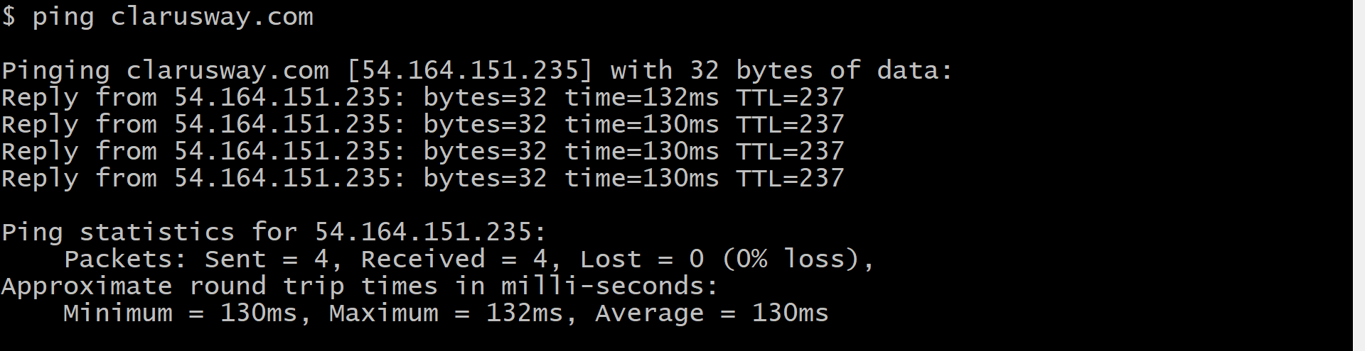
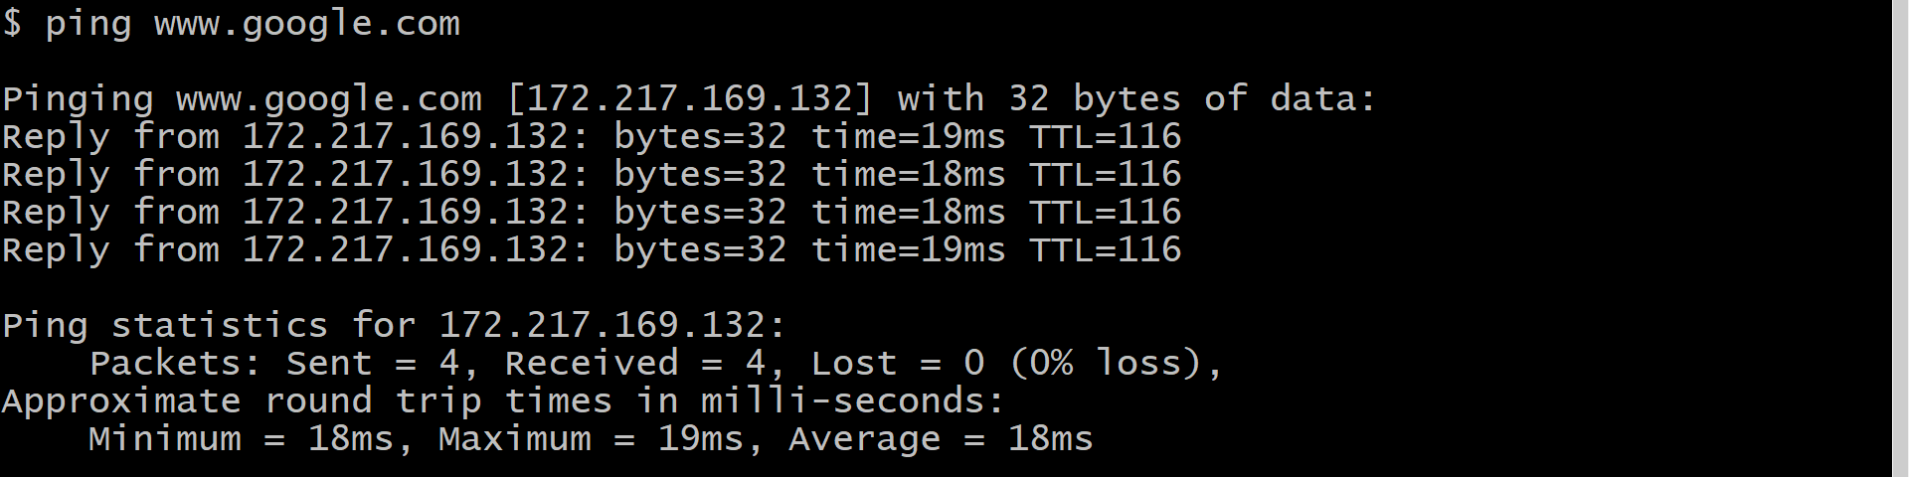
Ping Command

Slide 24
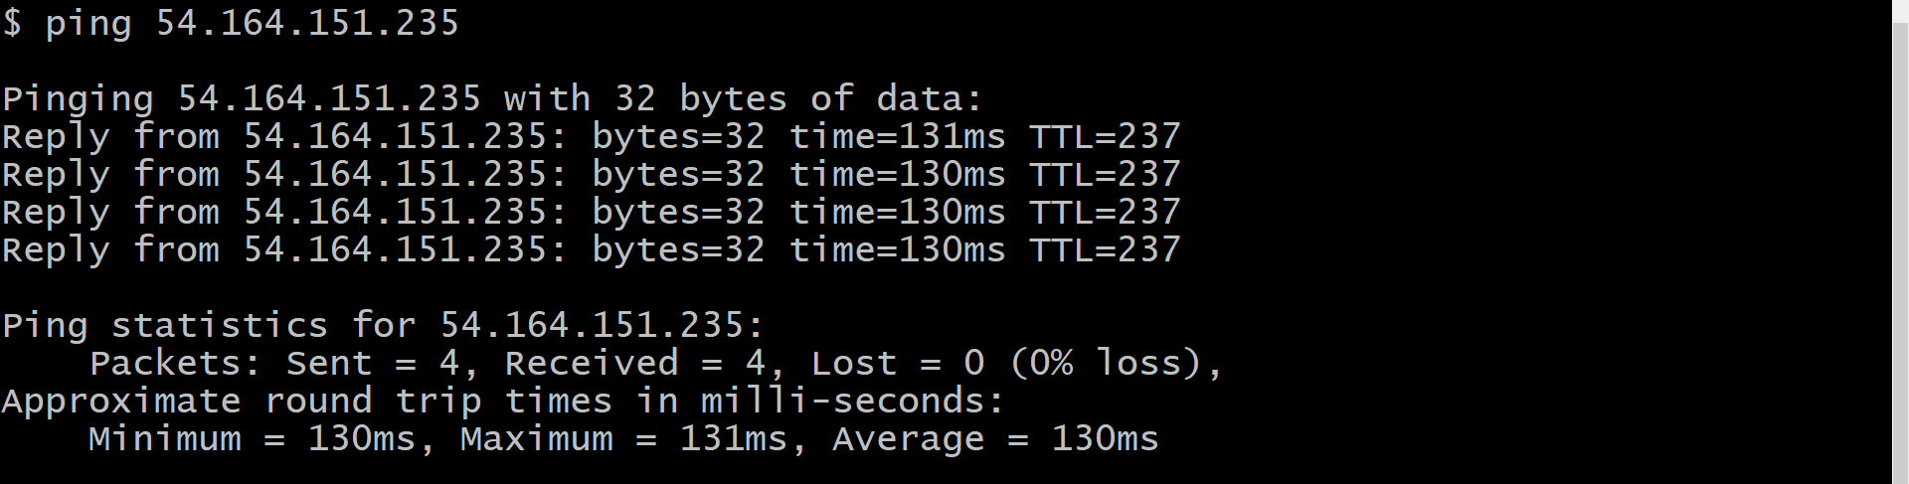
Ping Command

Slide 25
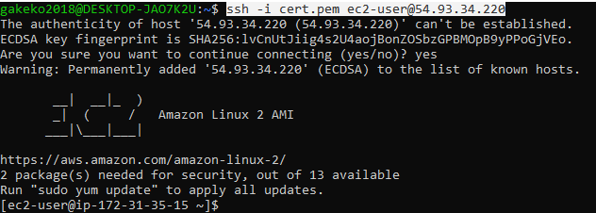
SSH Command
* ssh stands for “Secure Shell”.
* It is a protocol used to securely connect to a remote server/system.
ssh user@host(IP/Domain_name)
ssh -i cert.pem ec2-user@54.93.34.220

Slide 26
wget command
GNU Wget is a command-line utility for downloading files from the web. With Wget, you can download files using HTTP, HTTPS, and FTP protocols
wget [options] [url]
wget -O latest-hugo.zip https://github.com/gohugoio/hugo/archive/master.zip

Slide 27
curl command
curl (short for "Client URL") is a command line tool that enables data transfer over various network protocols
curl [options/URLs]
curl [url] > [local-file]
curl https://www.gnu.org/gnu/gnu.html

Slide 28

Kahoot!

Slide 29
THANKS!
Any questions?

Slide 30
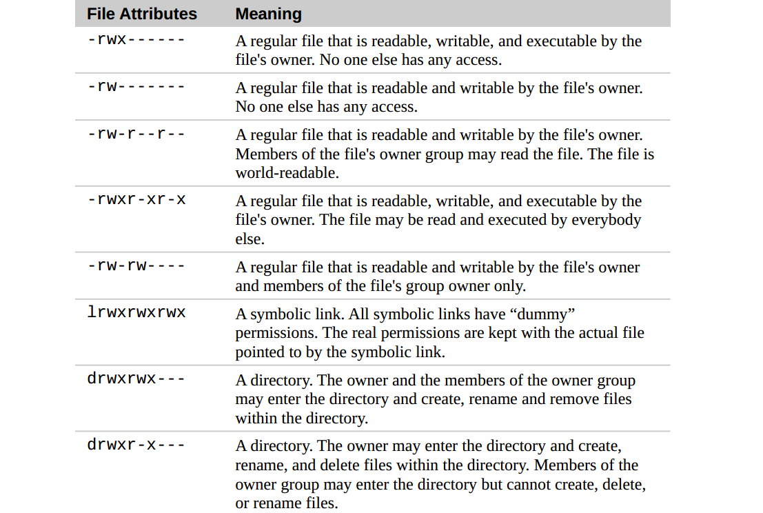

Slide 31
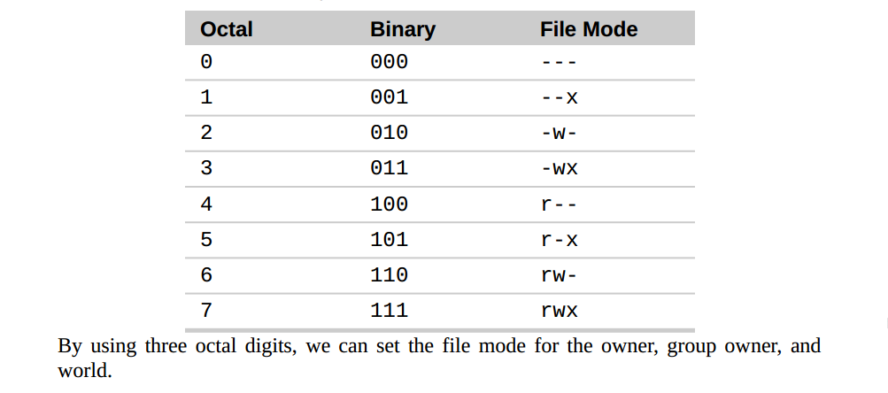

Slide 32
